Slide 1

GALGOTIAS COLLEGE OF ENGINEERING AND TECHNOLOGY
INDUSTRIAL PROJECT
(2021-2022)
COMMUNICABLE DIESEASE ANALYSIS AND VISUALIZATION
(DATA SCIENCE IN PYTHON)
MASTER OF COMPUTER APPLICATIONS
DEPARTMENT OF COMPUTER APPLICATIONS
SUBMITTED BY: AKASHDEEP AWASTHI
(1900970140006)

Slide 2
INDEX
INTRODUCTION
PROJECT SCOPE
AIMS AND OBJECTIVE
METHODOLOGY
4.1. Frontend
4.2. Backend
4.3. DFD
4.4. Class diagram
EXPECTED TIME SCHEDULE (Gantt Chart)
IMPACT OF PROPOSED SYSTEM IN ACADEMICS AND INDUSTRY
ROLES AND RESPONSIBILITY
PROS AND CONS
REFERENCES
CONCLUSION

Slide 3
INTRODUCTION
Communicable diseases are diseases that are as a result of the causative organism spreading from one person to another or from animals to people. They are among the major causes of illnesses in Kenya and the entire Africa. These diseases affect people of all ages but more so children due to their exposure to environmental conditions that support the spread. Communicable diseases are preventable base on interventions placed on various levels of transmission of the disease.
And the very widely spread one currently the “Covid 19” is also one of the communicable diseases. So to present the report of such diseases, this project is very reliable one. As it will perform the data analytics on the dataset and presents the result in a way which a normal human can understand easily.

Slide 4
PROJECT SCOPE
As the momentum to scale up the global response to communicable diseases increases, public health practitioners need to constantly review their performance in detecting and responding to communicable diseases. At the same time, they should account for the planned activities, policies and resources to a variety of stakeholders. The staff working at different levels of surveillance need to report accurate data in a timely manner to the next higher level to ensure timely and effective responses to contain communicable disease outbreaks. They may be required to report on progress to partners and donors, but most importantly, surveillance information should be used locally to address and resolve problems related to control of communicable diseases and to strengthen evolving programs. Monitoring and evaluation are keys to establishing and maintaining effective and efficient surveillance and response systems.
This project will help in data analyzing very efficiently.

Slide 5
AIMS AND OBJECTIVE
This strategic objective is the strengthening of multidisciplinary infectious disease research in Baltic, European and global dimensions, as a critically important part of health research, by unlocking the research potential at Riga Stradiņš University (RSU). The overarching objective will result in a coherent work plan based on five operational objectives: establishing two new laboratories at RSU and providing their necessary infrastructure: Laboratory of Digital Immunological Visualization and Laboratory of Infectious Diseases Modelling; upgrading competences of personnel in immunology visualization and in-silico and mathematical modelling in infectious diseases and rare disease research; fostering integration in the ERA by profiling infectious disease as the specialization area of RSU in tandem with Latvia’s 3S priority in biomedicine and medical technologies; rebuilding the innovation system at RSU according to the principles of the Innovation Union; and obtaining quality evaluation, which will foster improved participation in the Horizon2020 program.

Slide 6
METHODOLOGY
For the development of this project, the SDLC model is used is “The Waterfall Model”. The sequential phases in Waterfall model are:-
Requirement Gathering and analysis − All possible requirements of the system to be developed are captured in this phase and documented in a requirement specification document.
System Design − The requirement specifications from first phase are studied in this phase and the system design is prepared. This system design helps in specifying hardware and system requirements and helps in defining the overall system architecture.
Implementation − With inputs from the system design, the system is first developed in small programs called units, which are integrated in the next phase. Each unit is developed and tested for its functionality, which is referred to as Unit Testing.
Integration and Testing − All the units developed in the implementation phase are integrated into a system after testing of each unit. Post integration the entire system is tested for any faults and failures.
Deployment of system − Once the functional and non-functional testing is done; the product is deployed in the customer environment or released into the market.
Maintenance − There are some issues which come up in the client environment. To fix those issues, patches are released. Also to enhance the product some better versions are released. Maintenance is done to deliver these changes in the customer environment

Slide 7
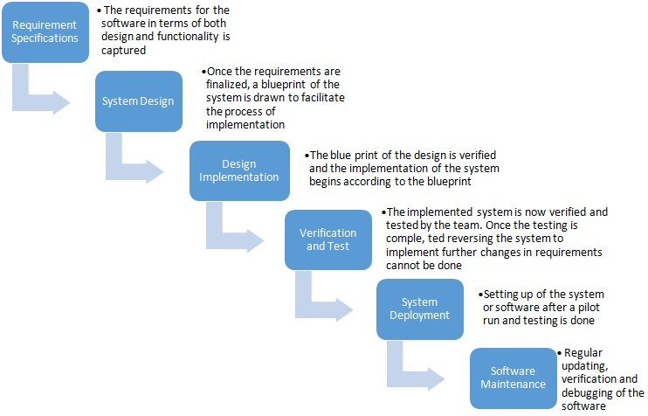
The following illustration is a representation of the different phases of the Waterfall Model:

Slide 8
FRONTEND
Streamlit :-
Streamlit is an open-source python library that is useful to create and share data web apps. It is slowly gaining a lot of momentum in the data science community. Because of the ease with which one can develop a data science web app, many developers use it in their daily workflow. The streamlit GitHub repository has more than 14.1k stars and 1.2k forks. Under the hood, it uses React as a frontend framework to render the data on the screen. So, React Developers can easily manipulate the UI with few changes in the code.With streamlit, one can build data apps in no time. It seamlessly integrates with other python libraries like NumPy, Pandas, Matplotlib, and many more.

Slide 9
Backend
Python :-
Python is a general-purpose, versatile, and
powerful programming language. It’s a great first
language because it’s concise and easy to read.
Whatever you want to do, Python can do it. From
web development to machine learning to data
science.

Slide 10
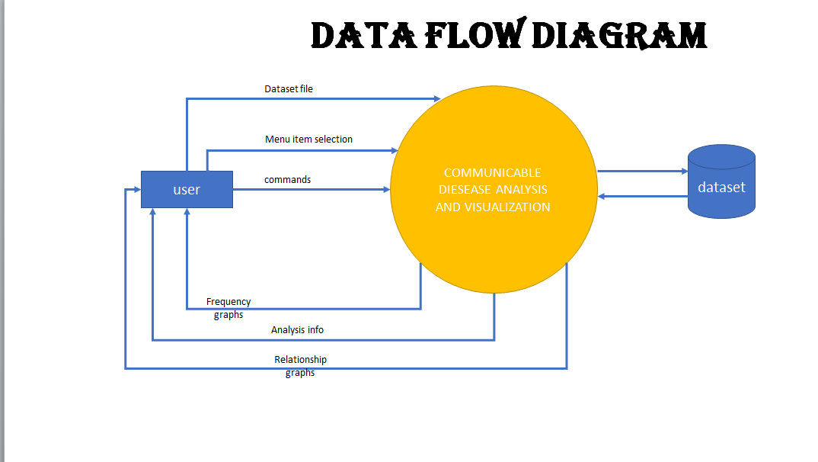
DATA FLOW DIAGRAM

Slide 11
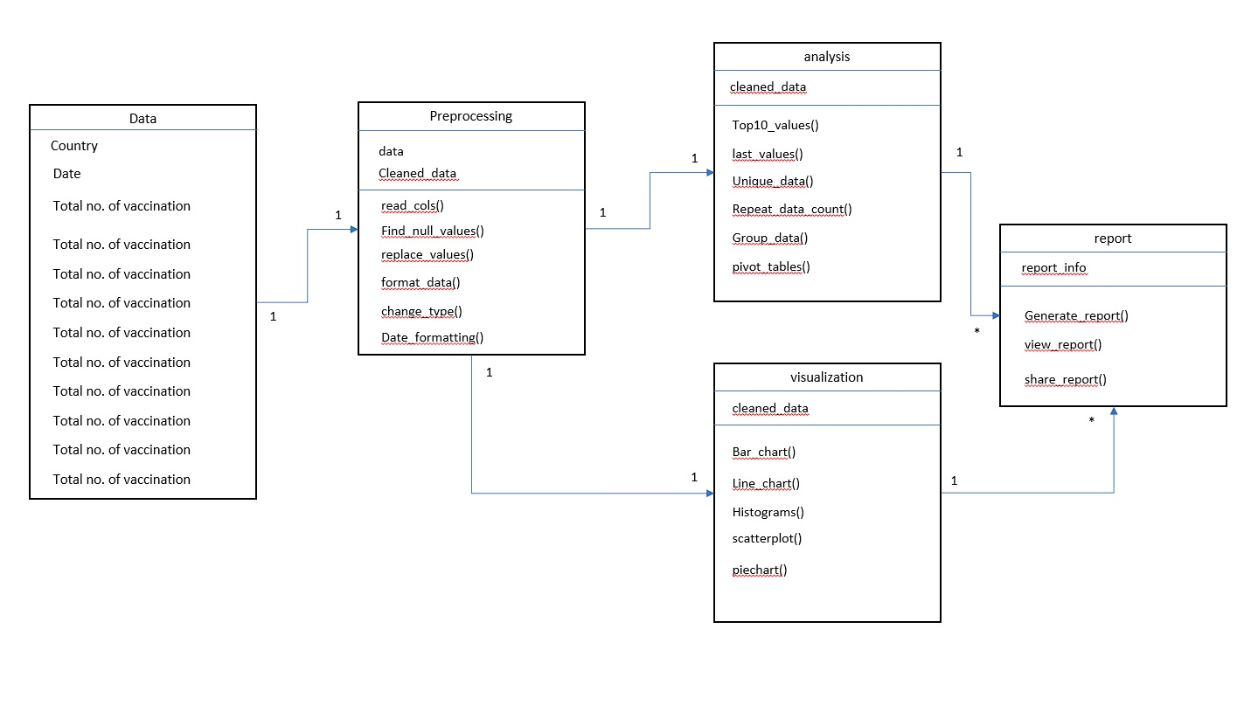
CLASS DIAGRAM

Slide 12
Resources (Hardware & Software) to be used:
Software requirements:
Operating system : Windows 10 or Linux
language : Python 3.8 or above
IDE : vscode
Database : SqLite
Browser : Chrome or Mozilla Firefox
Documentation tools : MS-word, MS-PowerPoint
Libraries: pandas, streamlit, plotly, sqlalchemy
Hardware requirements:
Processor : Intel i3 or higher
RAM : 4Gb or higher
Storage: approx. 2gb
Others : Internet

Slide 13
ROLES AND RESPONSIBILITY
Create overall project vision
Make key decisions within the project
Create the project plan
Manage components of the plan
Create a project schedule
Solve project objectives
Complete tasks in areas of expertise
Deliver project responsibilities within deadlines
Document progress, setbacks, and new processes
Assess solutions to make sure they are effective

Slide 14
PROS AND CONS
Pros of this projects are like, we can provide data set and it will efficiently analyze the data and provide us a results in a very easy and graphical way which any human being can understand.
The cons can be considered as it requires the data set and data set has to be updated on regular basis for exact manipulation and accurate results.

Slide 15
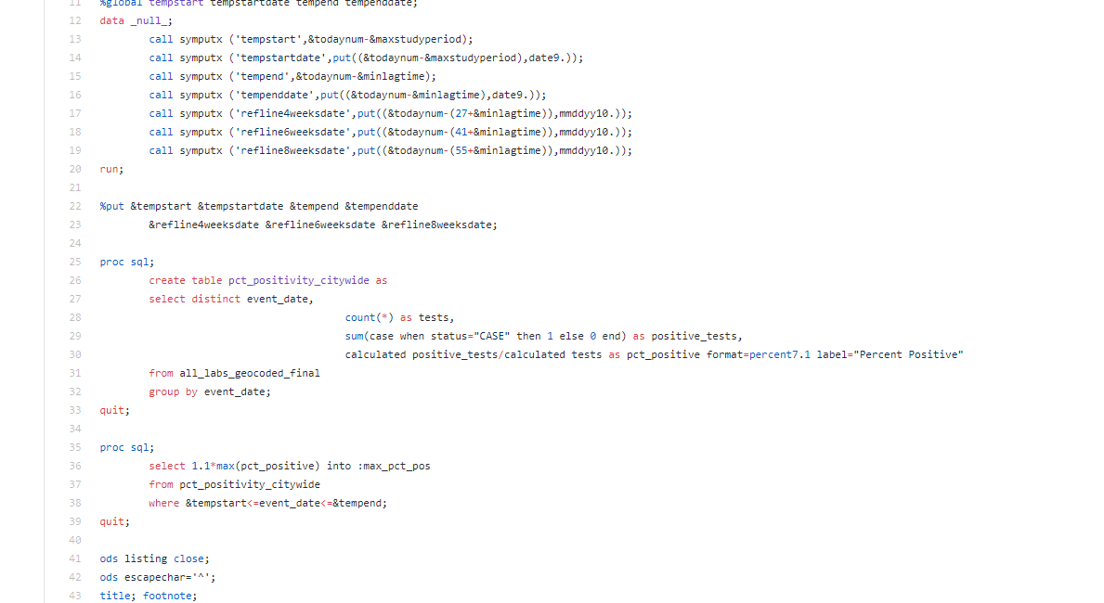
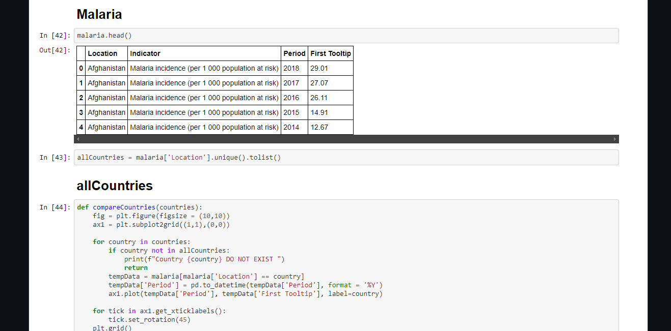
SCREENSHOTS

Slide 16
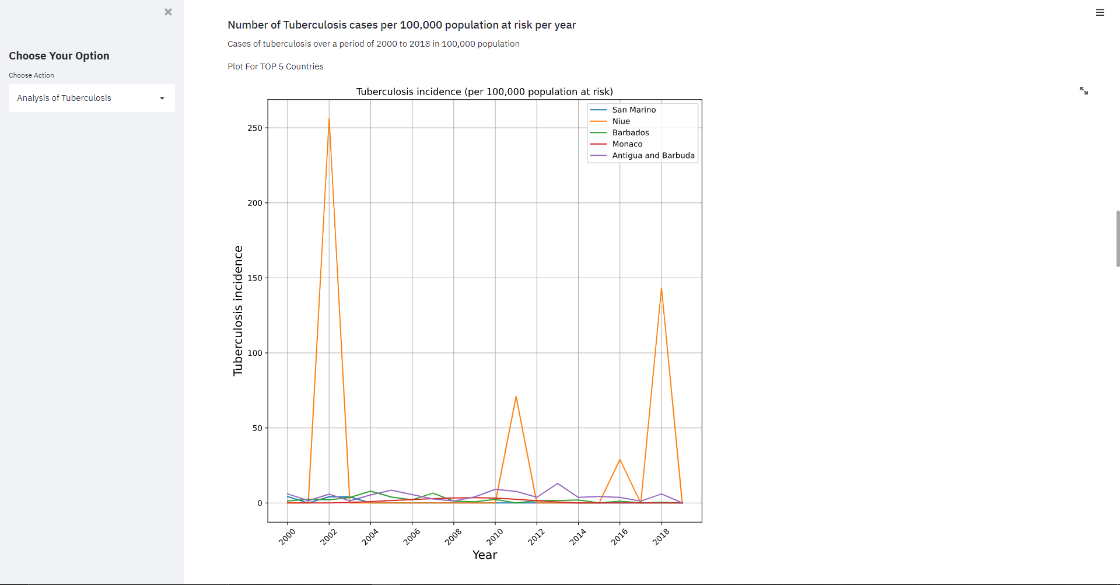
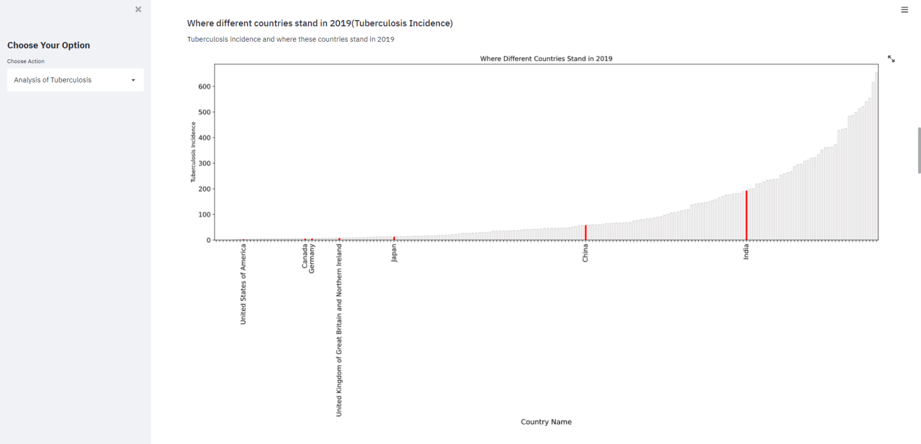

Slide 17
REFERENCE
https://link.springer.com/article/10.1007/s41060-018-0102-5
https://its.ucsc.edu/project-management/docs/brown-bag-docs/project-roles-and-resp-for-presentation.pdf

Slide 18
CONCLUSION
The system developed, had as its main objective to provide a means of surveillance of notifiable diseases in world, in real time. This goal was achieved, and it is now possible to use the Labs to obtain real-time information about the current state of laboratory notifications of notifiable diseases in the world. In terms of the requirements, were all achieved, since it is possible to view in real-time information about the incidence of notifiable diseases by several factors such as geography, age groups and gender. The system also allows you to see trends and developments over time.

